Slide 1
Likes and dislikes
03. Gerunds

Slide 2

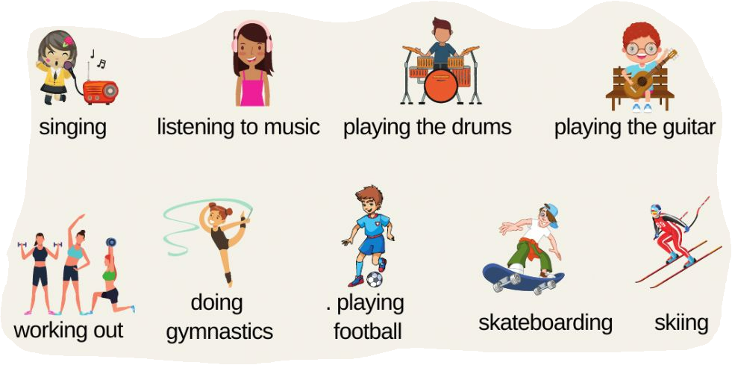
Likes and dislikes
What do you like doing after work?
What did you dislike doing when you were a child?

Slide 3
Gerunds
Gerund is a noun made from a verb by adding "-ing." You can use a gerund as the subject, the complement, or the object of a sentence.
Reading helps you learn English. subject of sentence
Her favorite hobby is reading. complement of sentence
I enjoy reading. object of sentence
Gerunds can be made negative by adding "not."
He enjoys not working.
The best thing for your health is not smoking.
Gerunds can be used after the verbs love, like, dislike, hate, and enjoy.
Notes:
Ask your friends what activities they like or dislike.
Example:
Student 1: Do you like fishing?
Student 2: No, I don’t. Do you dislike riding horses?
Student 3: Yes, I do. Do you like riding bikes?

Slide 4
When do we use gerunds?
After prepositions: You are capable of working in teams.
Subject of the sentence: Working after hours reduces productivity.
After these verbs: I despise eating in a hurry.
admit | despise | discuss | practice | recall | spend (time)
anticipate | deny | imagine | miss | report | understand
avoid | delay | involve | mind | resent | tolerate
complete | consider | keep | mention | risk | suggest

Slide 5
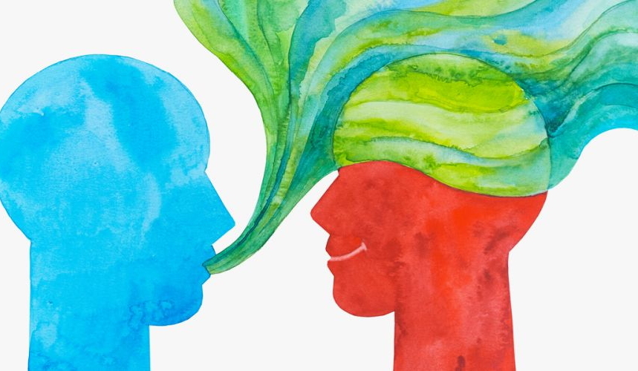
Complete the next sentences
Remember to use a gerund.
It’s no good…
It’s no use…
It’s not worth…
There’s no point in…
I am used to…
I am really excited about…
I can’t live without…
I am thankful for…
I am really good at…
I am really bad at…
I am looking forward to…
I spend a lot of time…

Slide 6
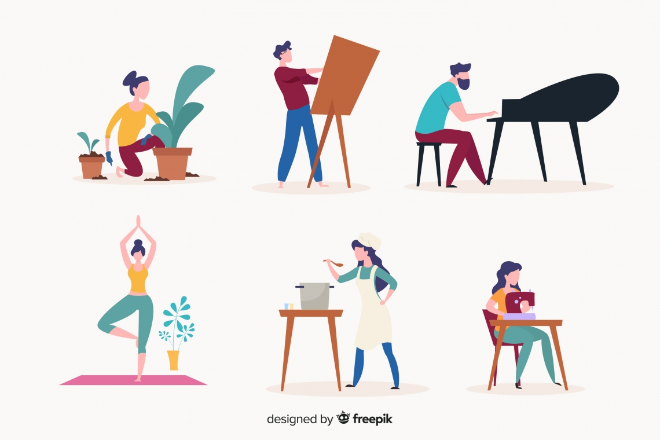
Persuade your coworker
What is an activity that you really enjoy doing? Why?
Mention something you’re interested in doing.
Convince your coworkers to start doing it as well.
Notes:
https://create.kahoot.it/details/54219b78-abe6-44cc-9992-fa9a2a06a373

